Slide 1
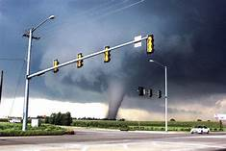
PROJECT-
WIND STORM PREDICTION

Slide 2

Storm prediction
Simple introduction:
What is storm? when does it occur?
what are the major factors?

Slide 3
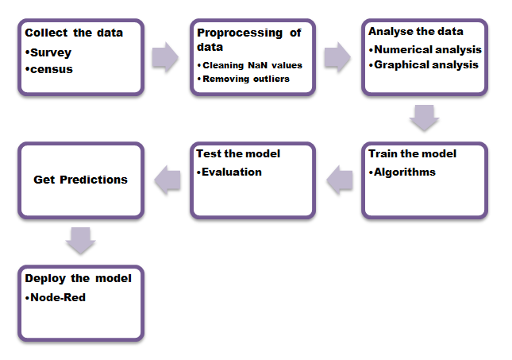
ML WORKFLOW

Slide 4

Exploratory Data Analysis
EXPLORATORY DATA ANALYSIS(EDA) is an approach to analyse datasets and summarise their main content
HISTOGRAM
BOXPLOT
HEAT MAP
SCATTER PLOT
DISTRIBUTION PLOT

Slide 5
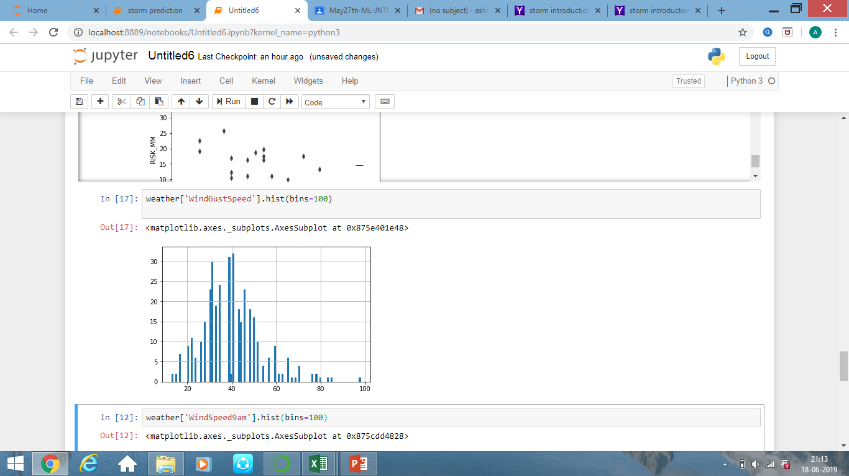
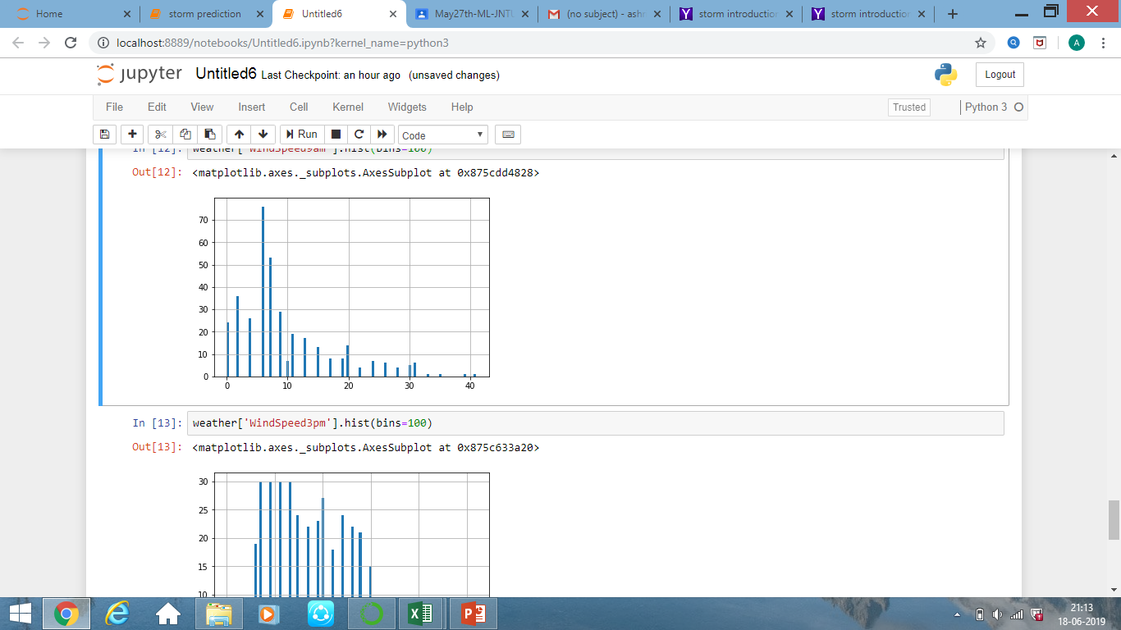
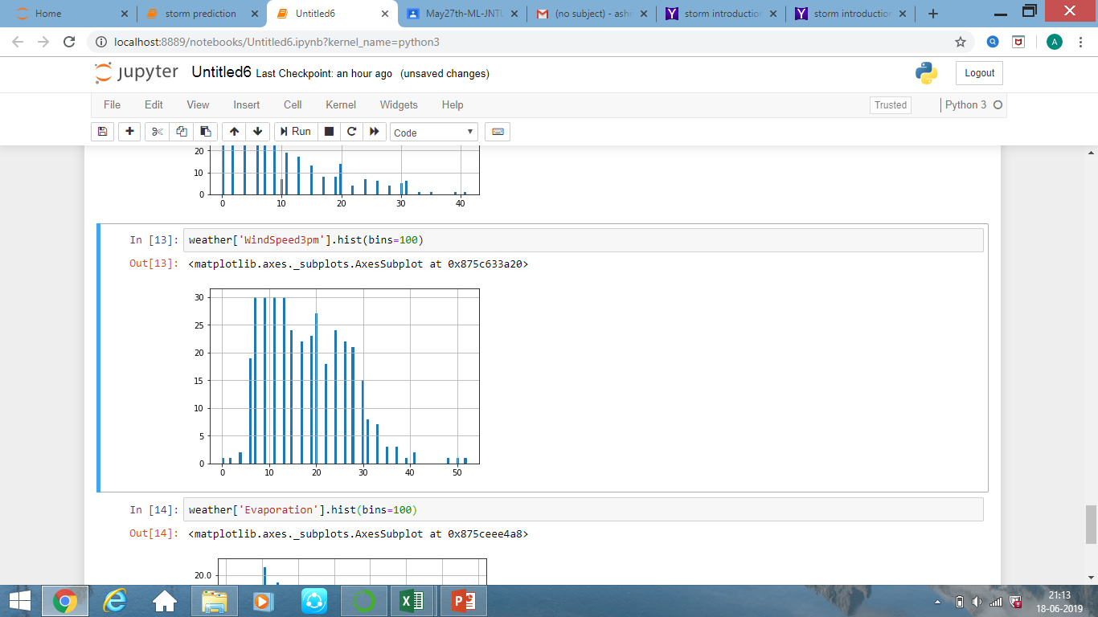
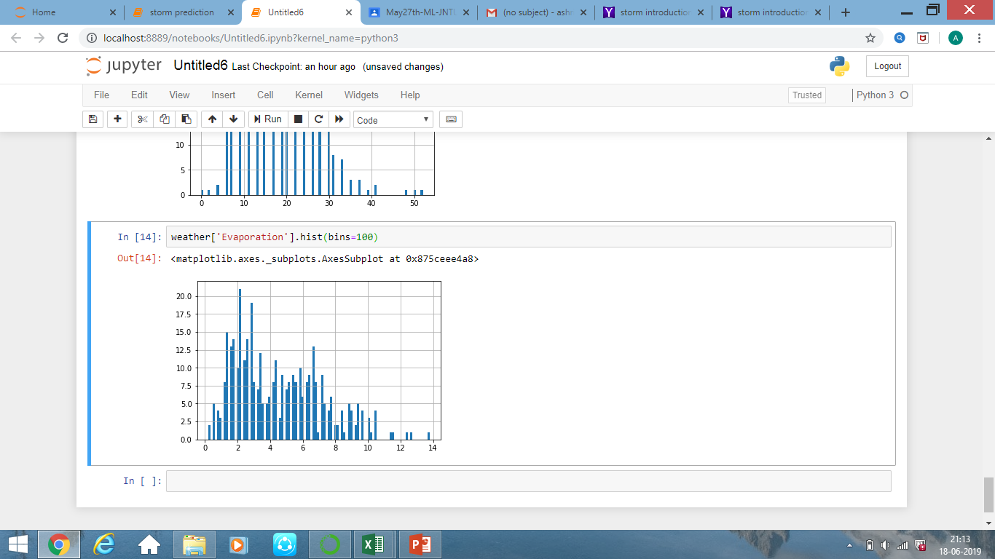
HISTOGRAM
Representation of distribution of numerical data

Slide 6
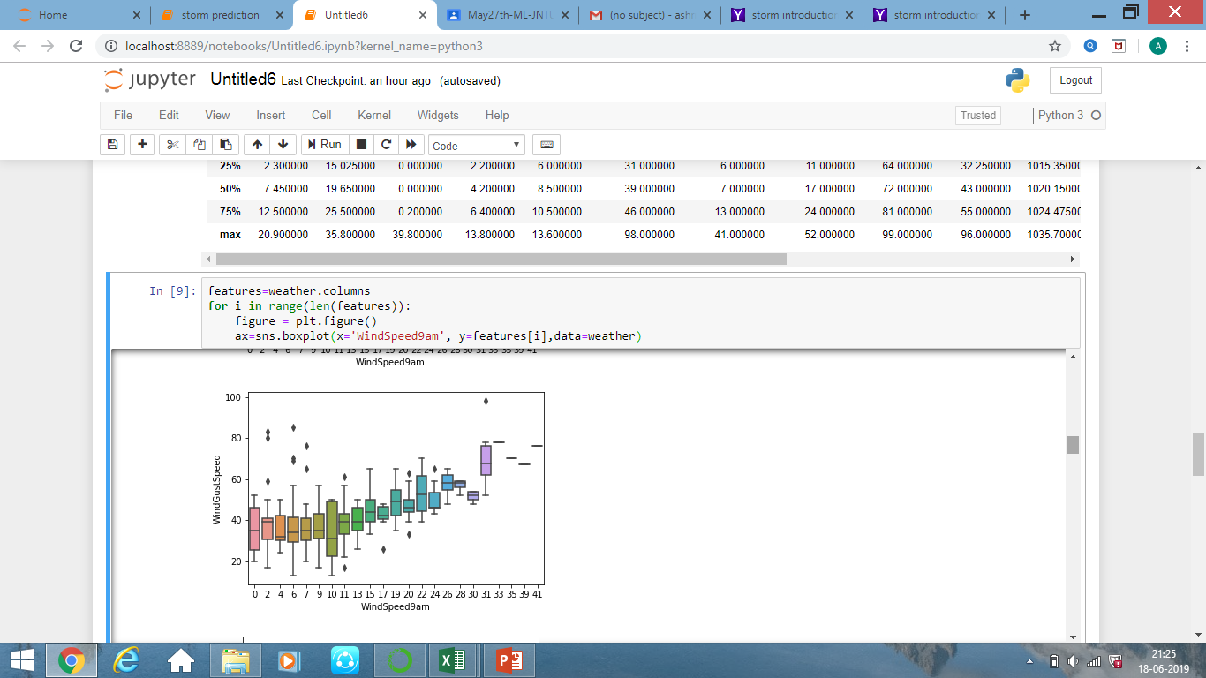
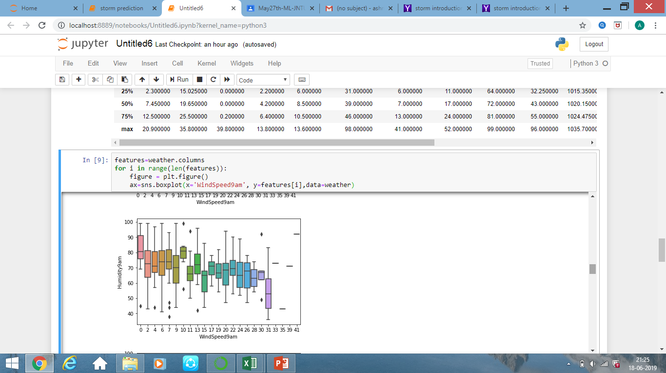
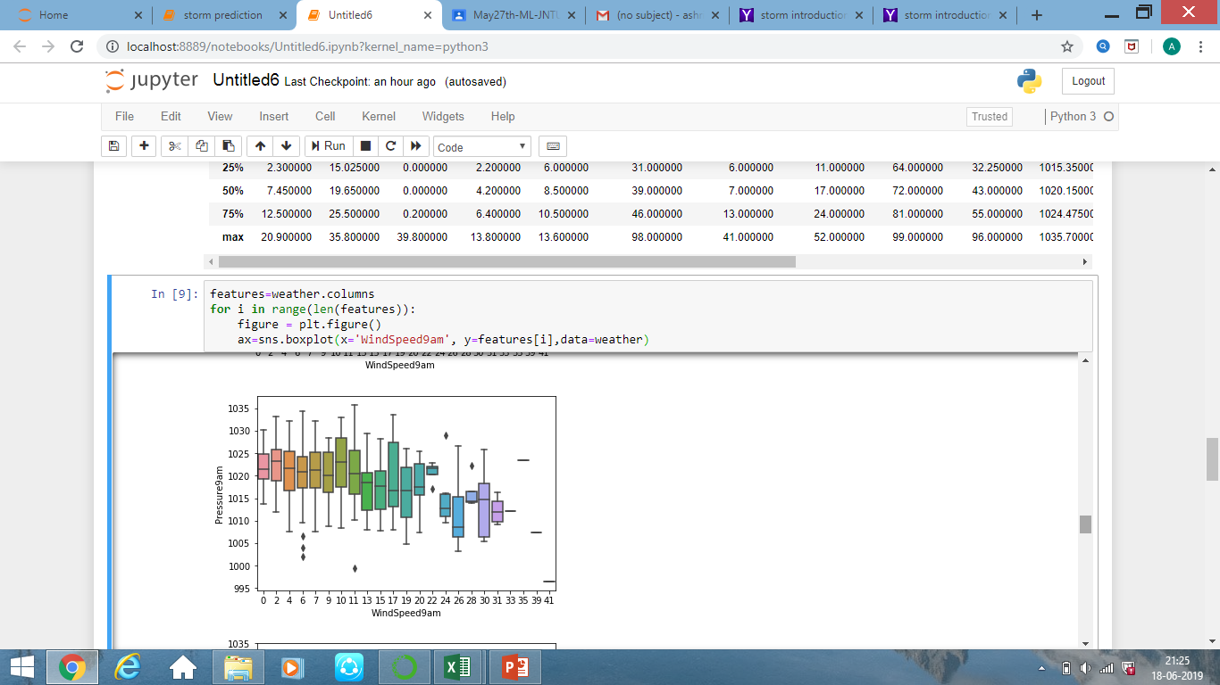
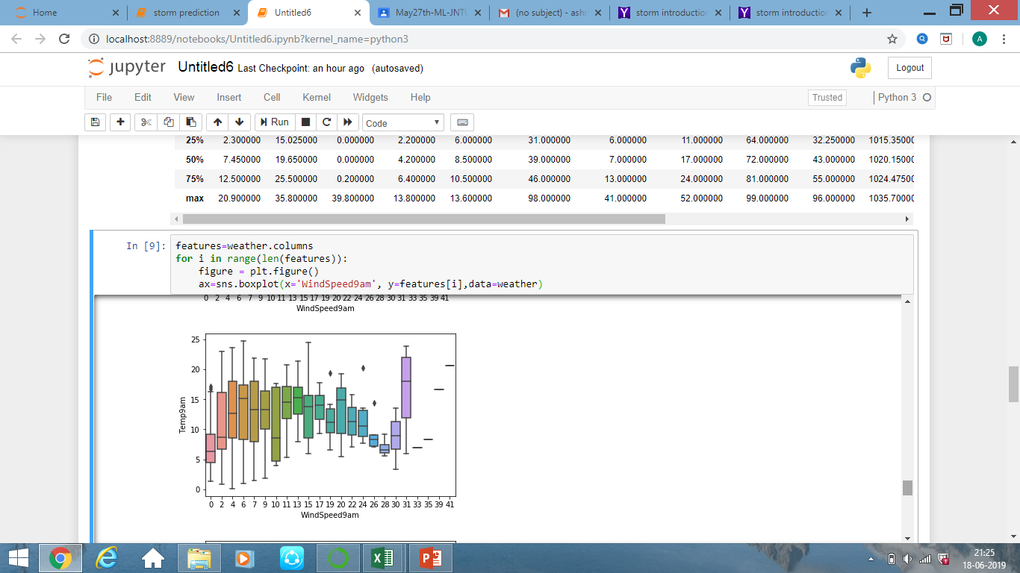
BOXPLOT
Representation of group of numerical data through their Quartiles
Boxplots with respect to WINDSPEED9AM

Slide 7
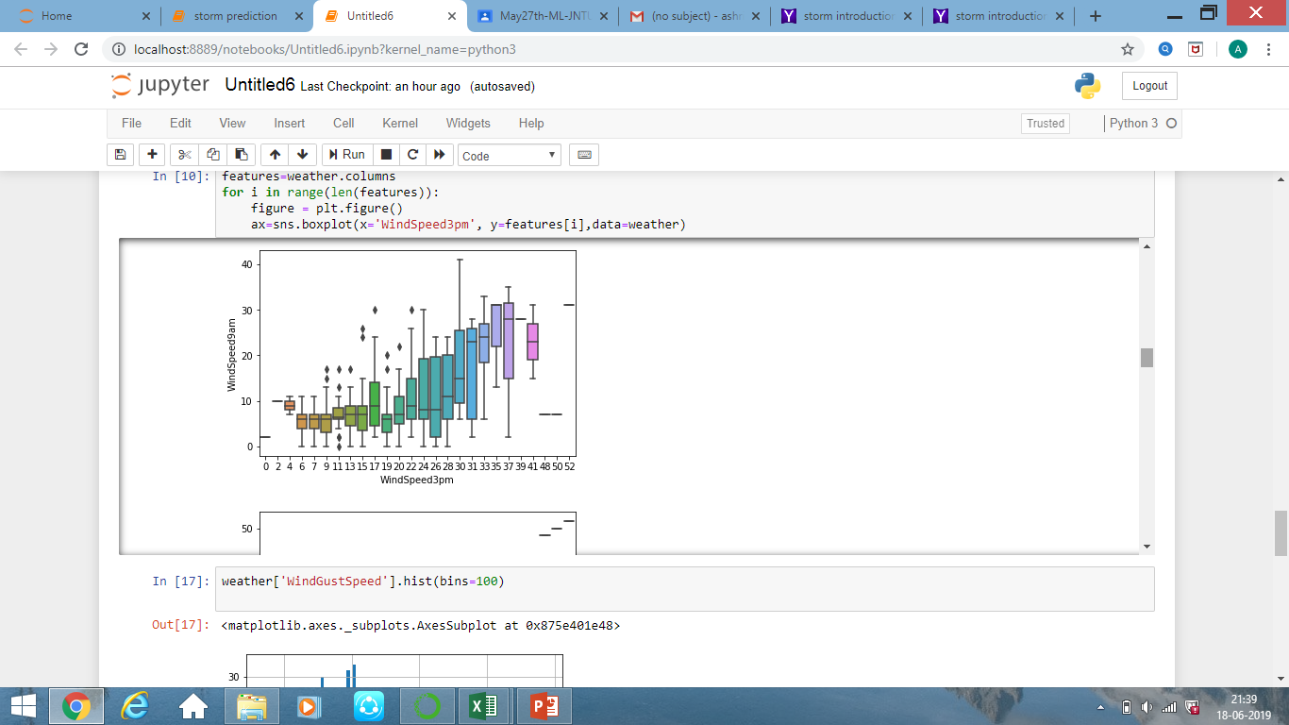
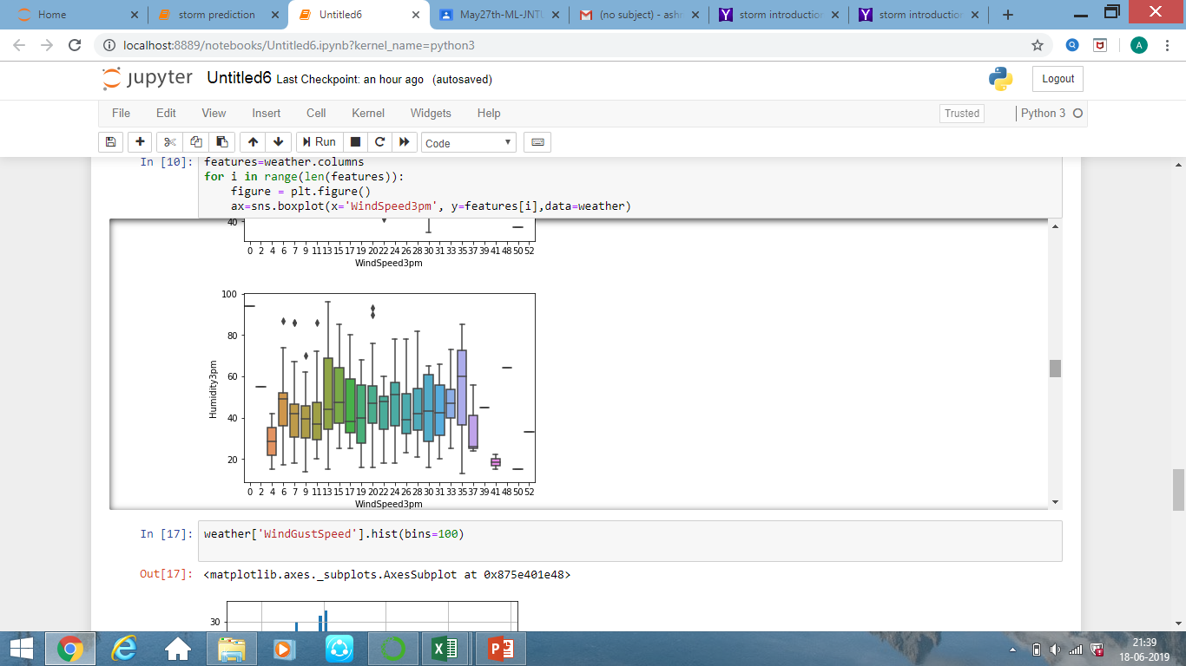
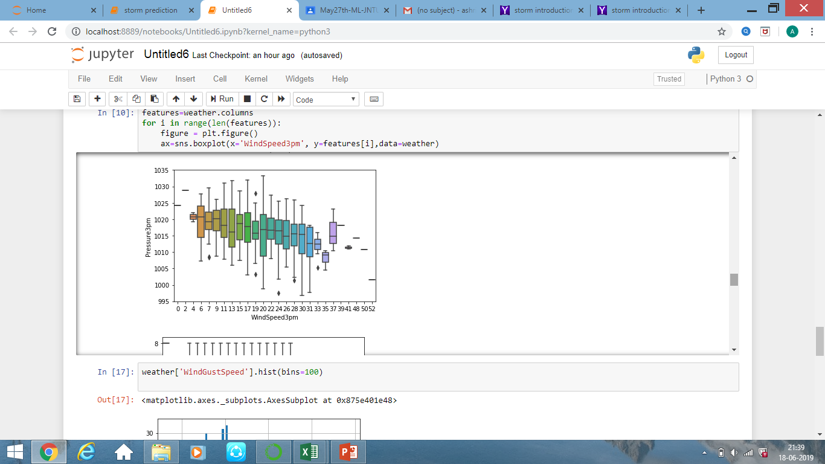
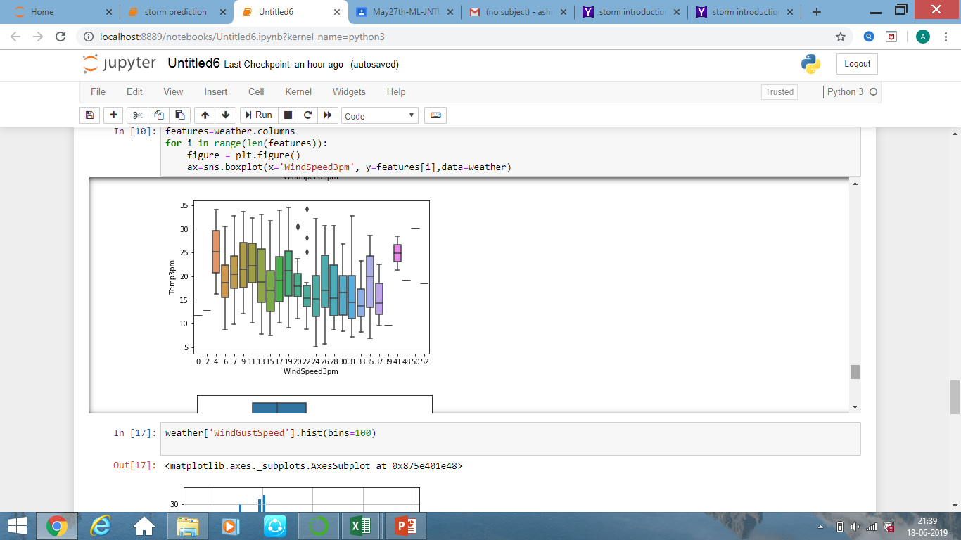
Boxplots with respect to WindSpeed3Am

Slide 8
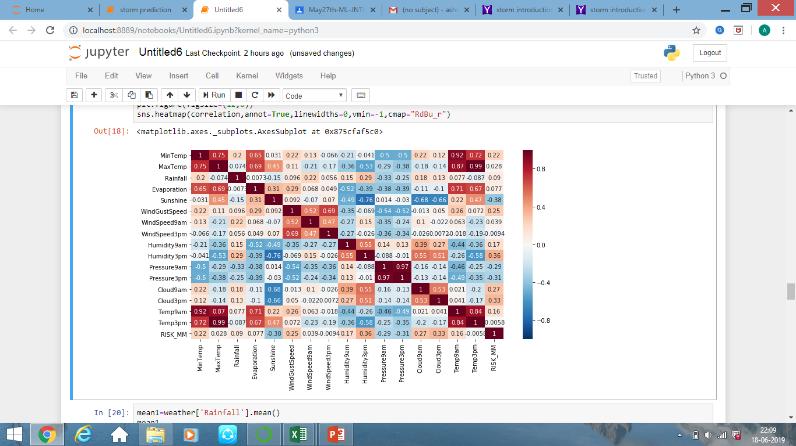
HEAT MAP
Representation of distribution of single variables and relationships between two variables

Slide 9
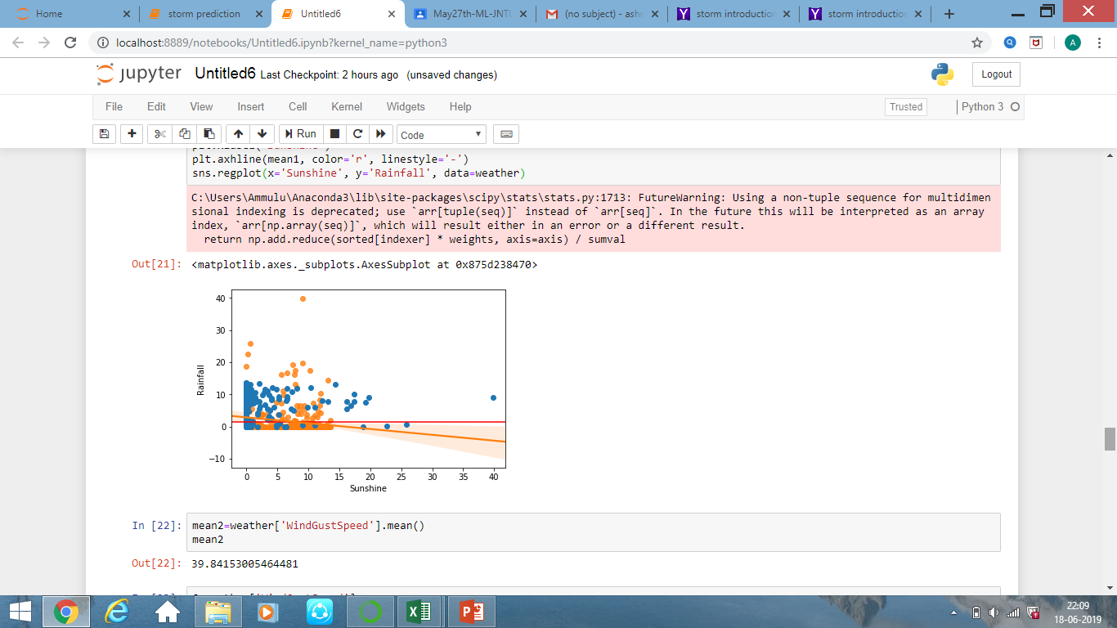
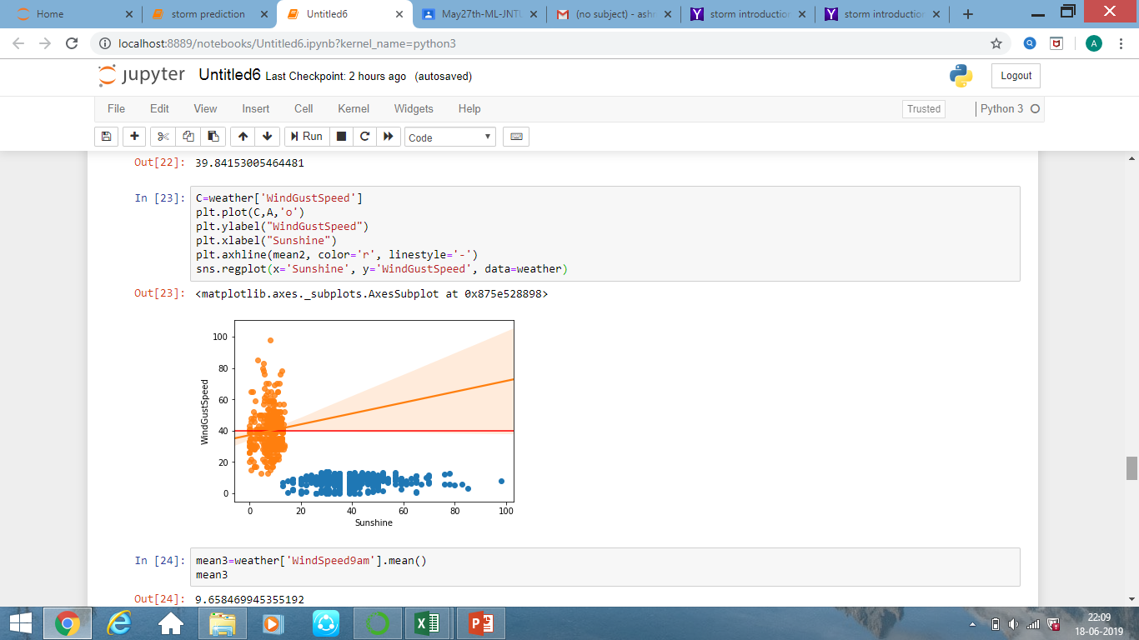
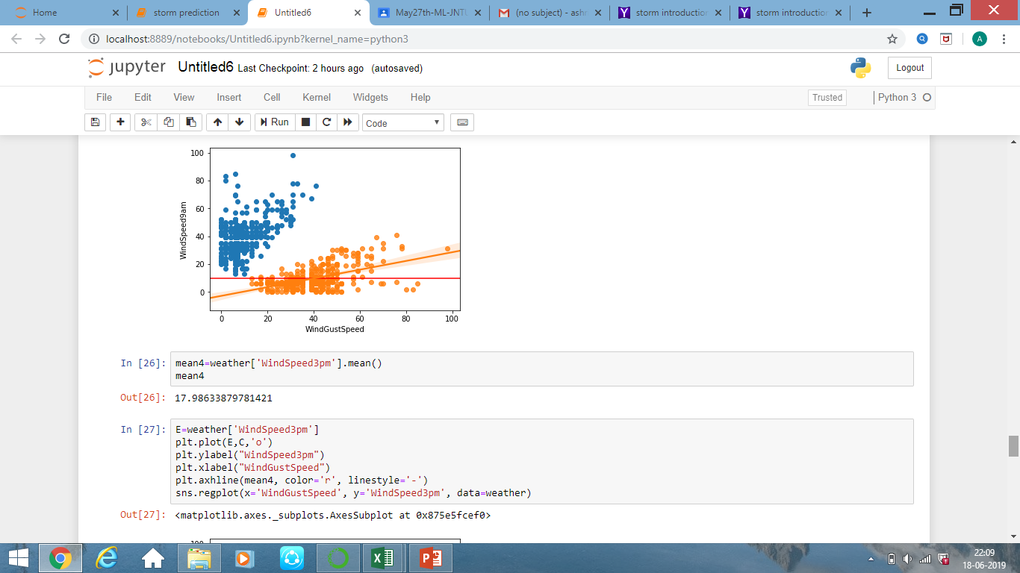
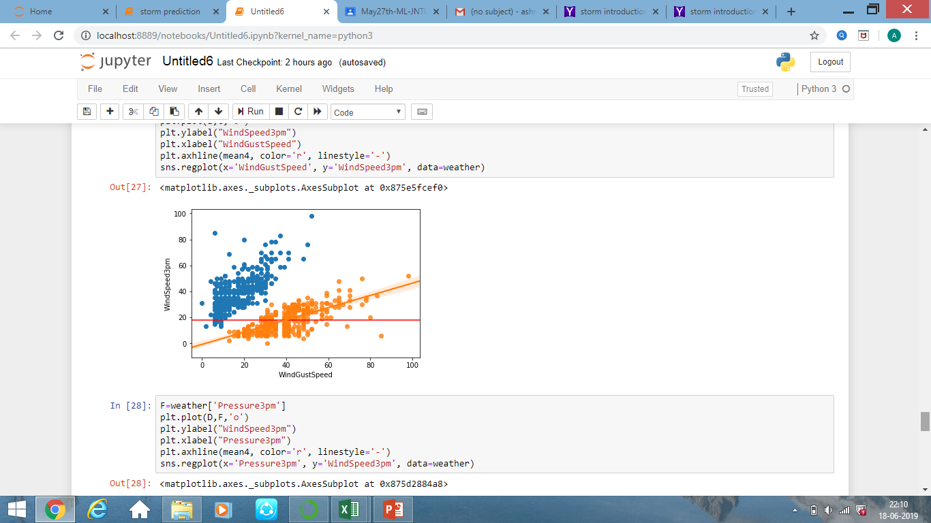
SCATTER PLOT
Representation of set of points plotted on a horizontal and vertical axes

Slide 10
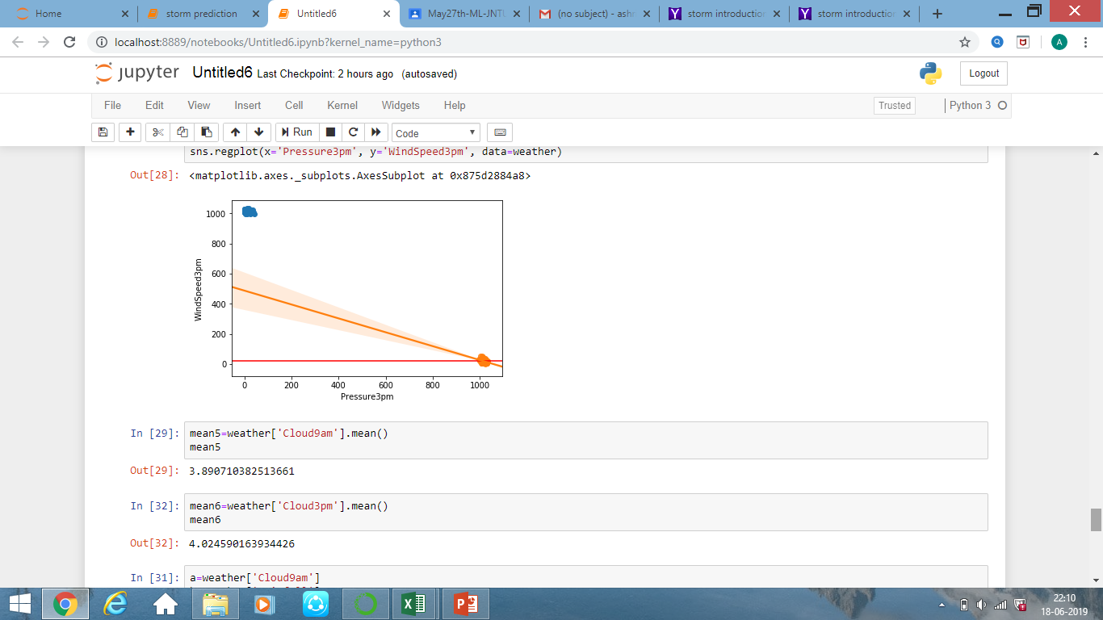
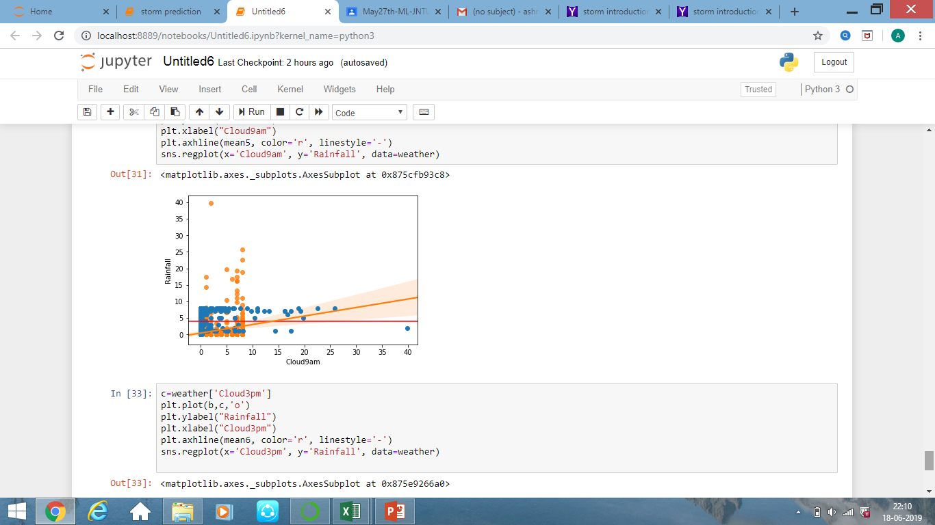
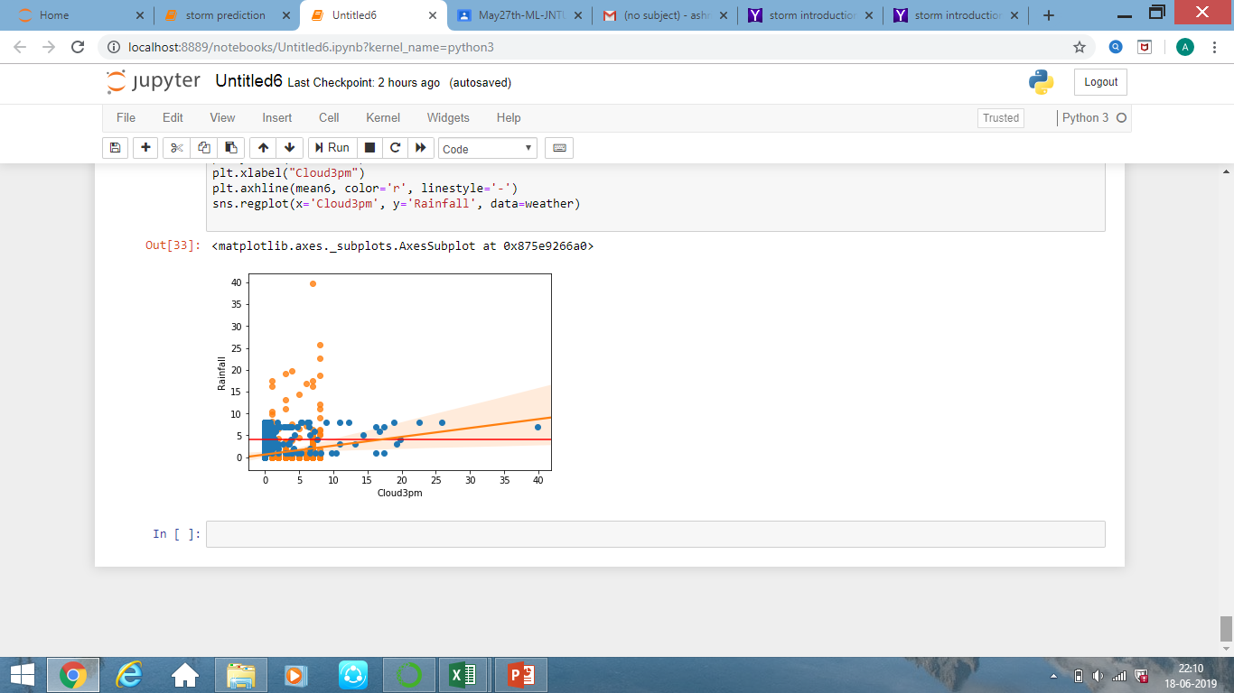
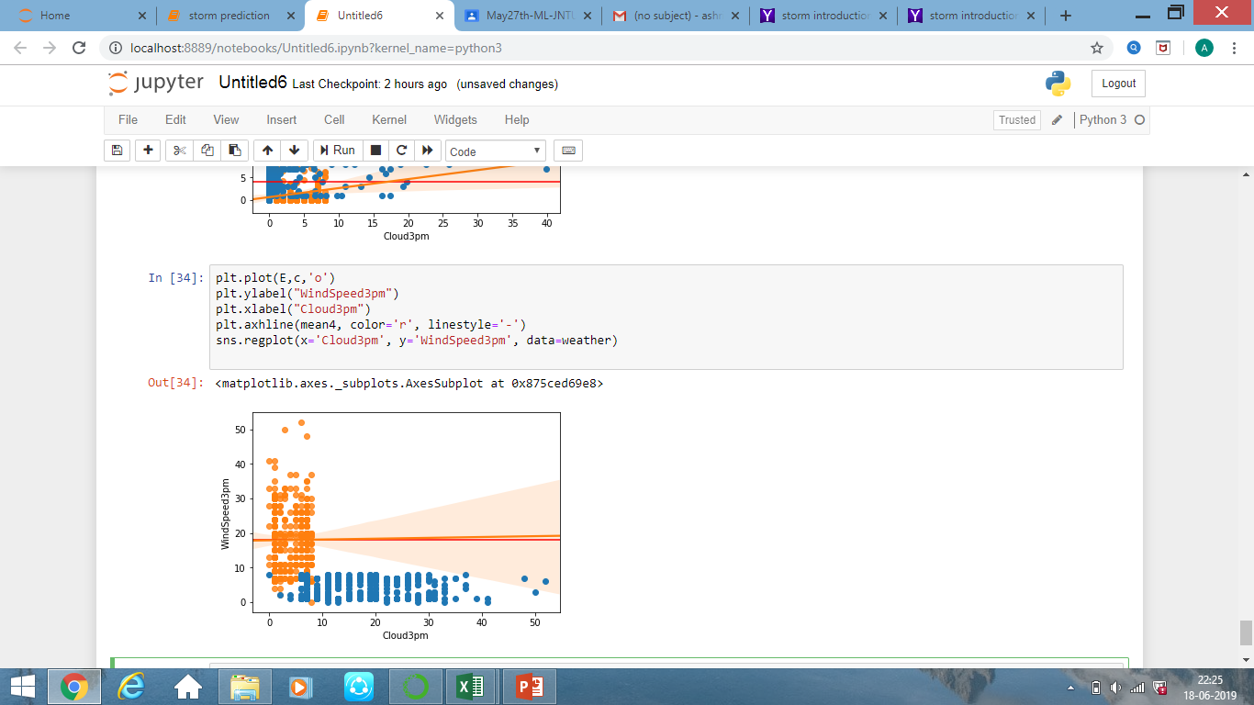

Slide 11
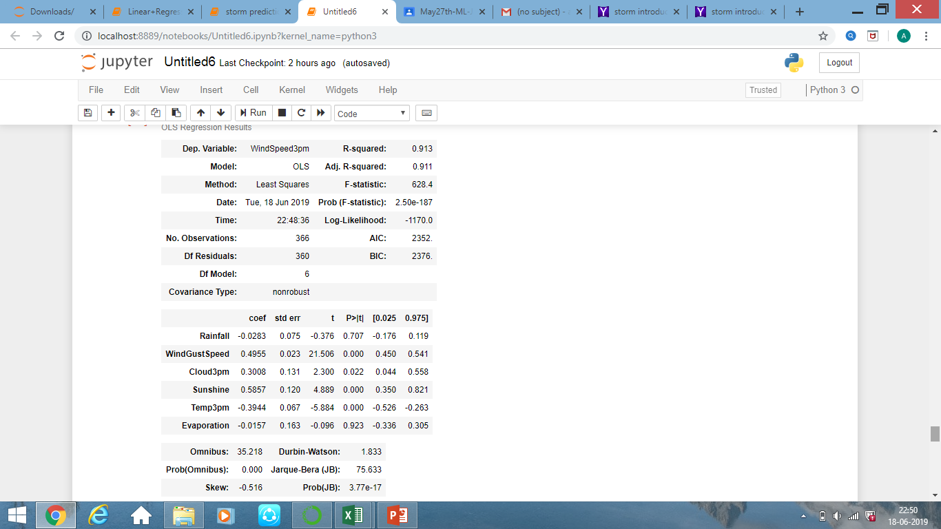
OLS regression results

Slide 12
Linear Regression
(single variant)
TEST DATA SIZE | FEATURES AND LABELS | ACCURACY
0.2 | Pressure(FEATURES) WindSpeed3pm(LABEL) | 15.0

Slide 13
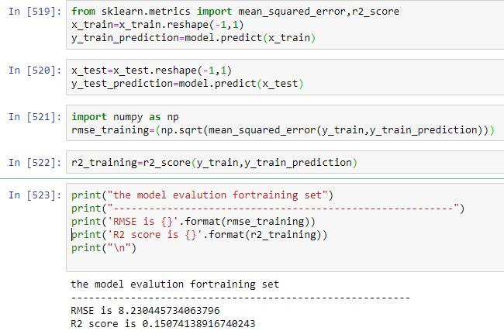
Linear Regression
(single variant)

Slide 14
Linear Regression
(multi variant)
TEST DATA SIZE | FEATURES AND LABELS | ACCURACY
0.2 | WindGustSpeed,Cloud3pm,Sunshine,Temp3pm,Evaporation(FEATURES) WindSpeed3pm(LABEL) | 57.2

Slide 15
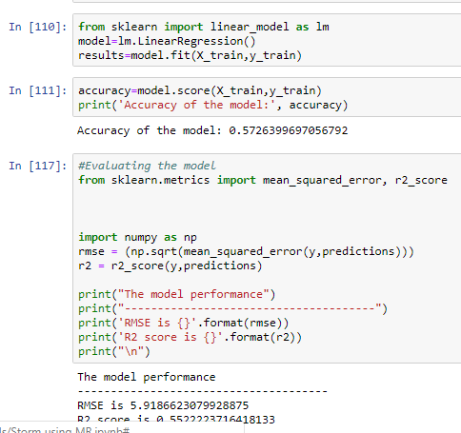
Linear Regression
(multi variant)

Slide 16
OVERVIEW
Test data size | Features | Accuracy
0.2 | ALL INPUT FEATURES | 57.2%

Slide 17
SUMMARY
Finally,after analysing the complete data we found that the multi-variant LinearRegression produces good results than single variant LinearRegression.

Slide 18
# PRESENTED TO YOU BY TEAM CTRL_ALT_HACK
G.Ashritha
B.PavanRaj
Vaishnavi.ch
Rohitha

Slide 19


